Slide 1



W / Friends
Keep in touch everywhere with your friends!

Slide 2
Index
3. Introduction
4. HomePage Style
5. Database
6. Firewall Rules
7. Guntt Chart
8. Expectations
9. Conclusion

Slide 3
Netherlands Project
This project is a collaboration between “mboRijnland” and “City College of Plymouth” that allows students to work and learn together.
The web application we are developing is called “W/ Friends”.
It is a web social application with the practical main function designed to help friends meet.
The map based software will show you where your “friends” are and will allow to chat with them and set meeting points for specific events. In addition, users are also able to write specific tailored reviews of places such as restaurants, pubs, clubs and shops created by your “friends”.
Pick a place to meet your friends (GPS system)
See where your friends are going to
Personal specific recommendations/ratings of places on the map
Our target audience is age 16+
6-digit code to add each other as friends (QR code can be added to manage friend requests)
Secure login/register page (CAPTCHA I am not a robot)
Chat with people in proximity.

Slide 4
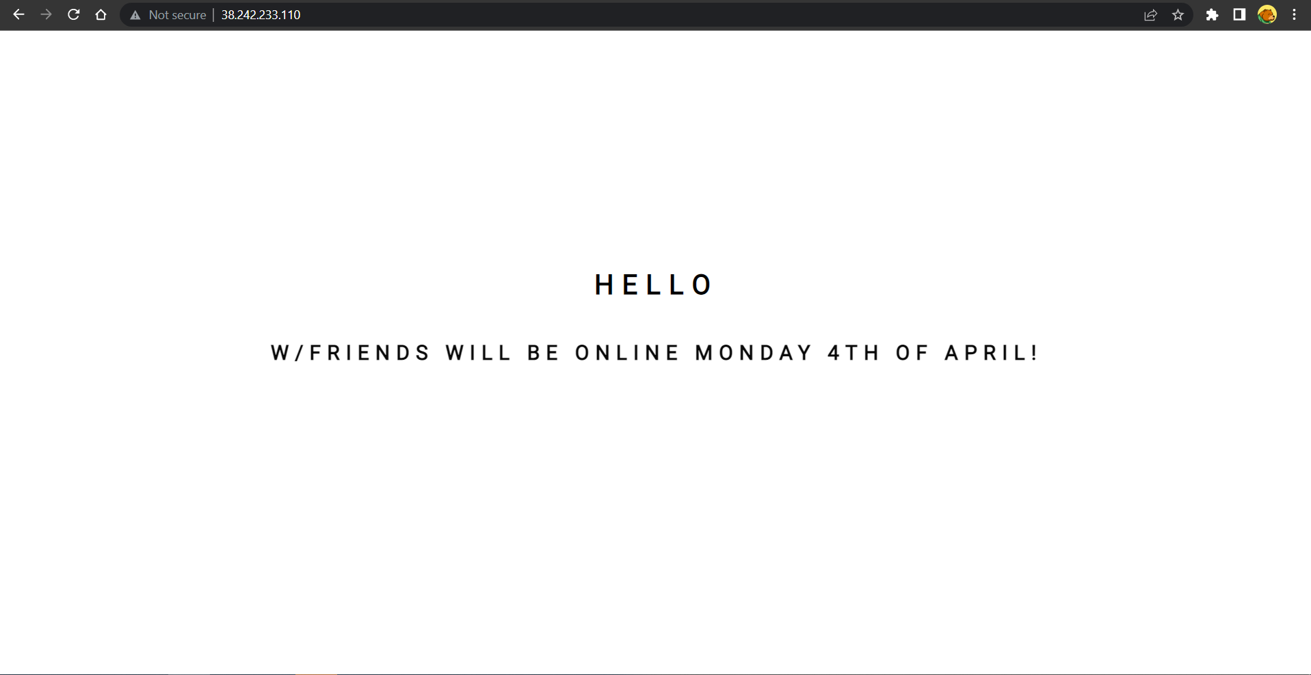
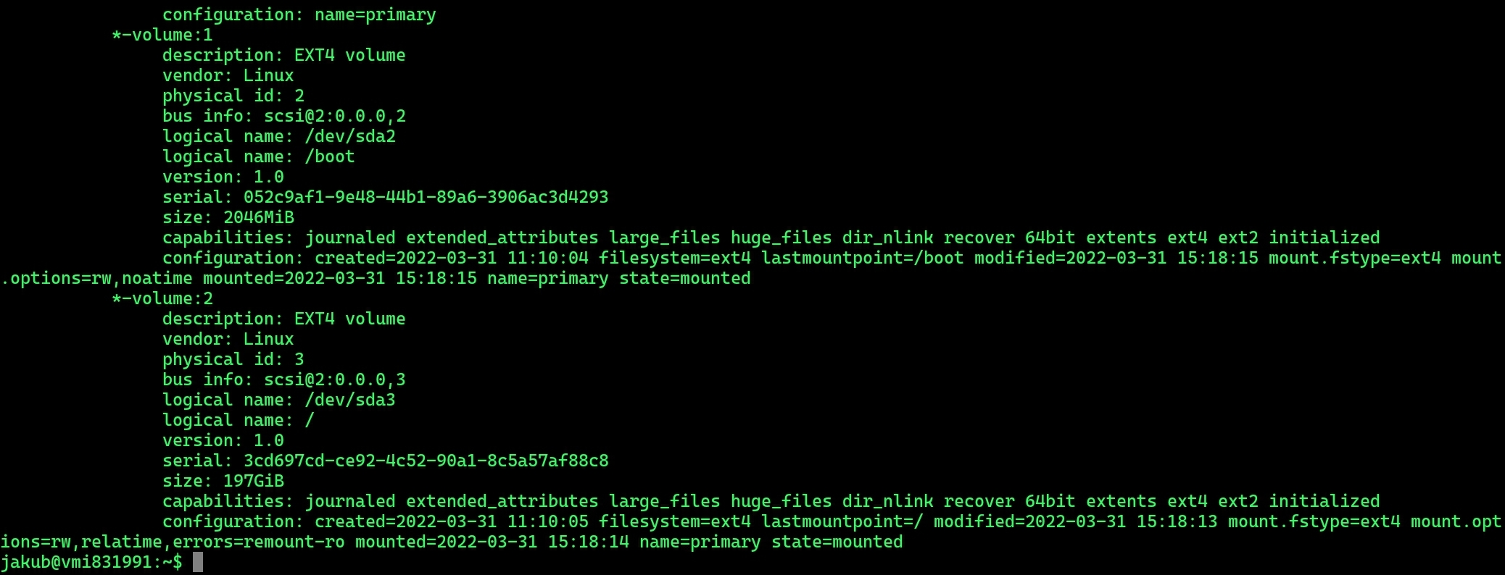
Setting up the Server
Mysql​
PHP​
Apache2
phpMyAdmin

Slide 5
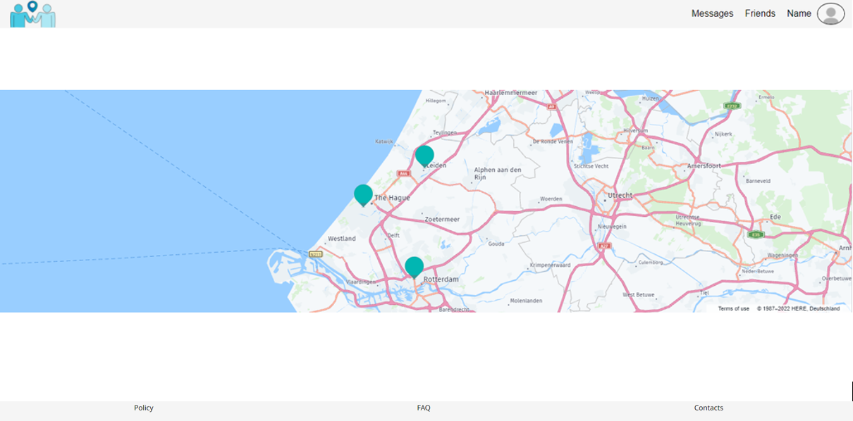
Homepage style

Slide 6
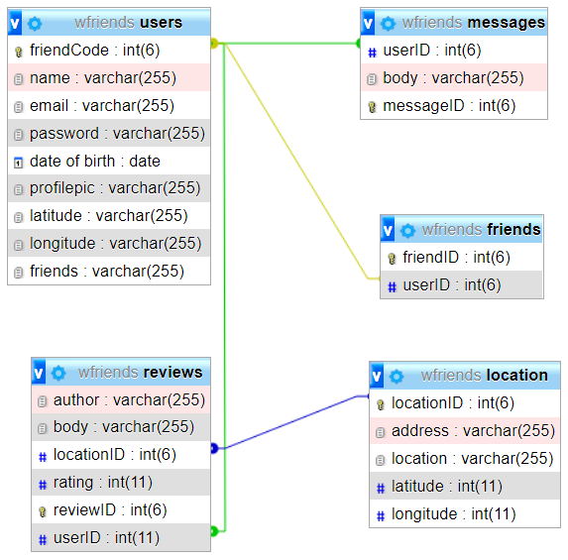
Database

Slide 7
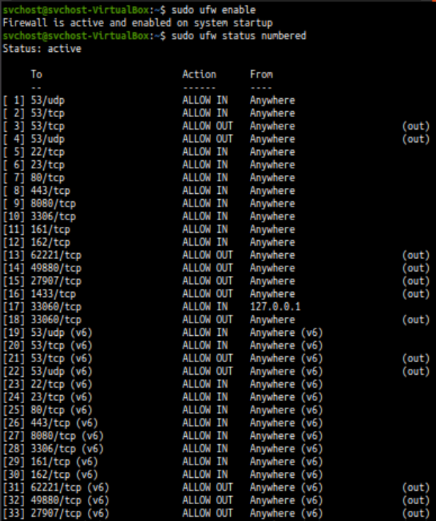
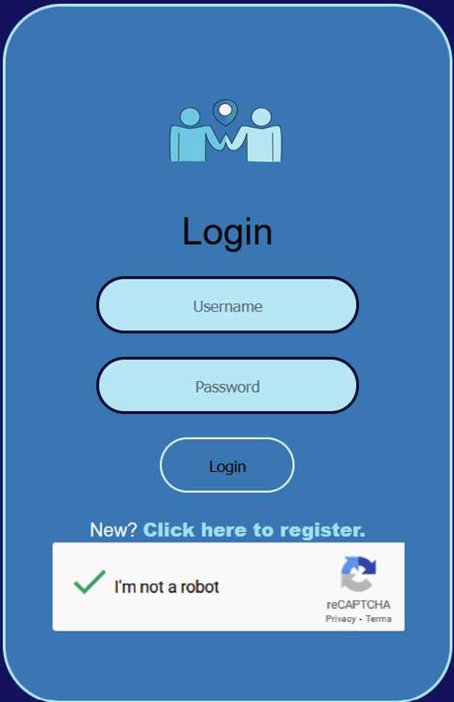
Firewall rules

Slide 8
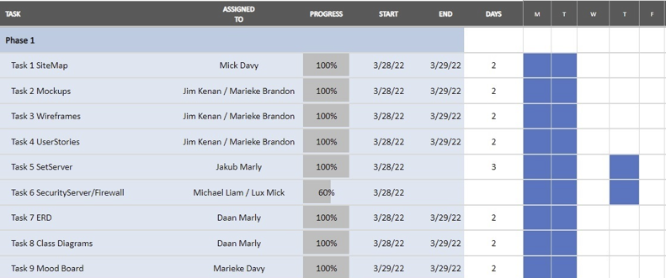
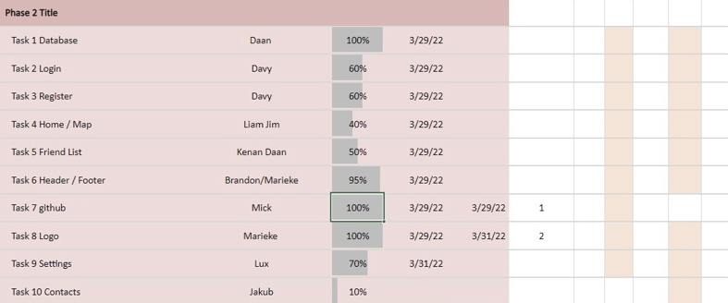
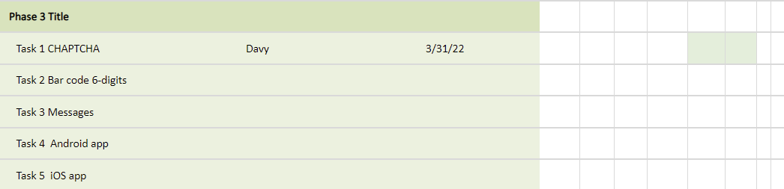
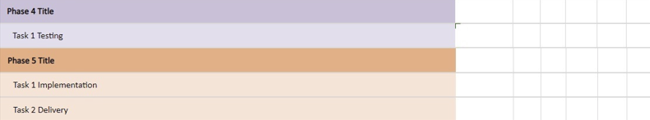
Guntt Chart

Slide 9
Expectations
For this project our expectations are:
Understanding how to work in teams
Learning about several technologies
Delivering an almost fully prototype implementing complex features (time might affect our product)
Make new friends!

Slide 10
Conclusion
We would like to thank all of you for your hospitality and for participating at our presentation
QUESTIONS??

